Slide 1


Slide 2

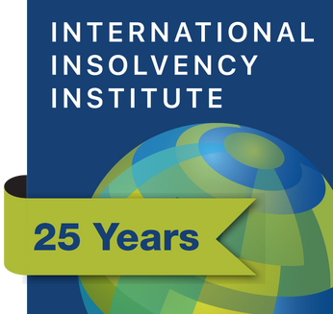
Protection and Deference
The Promise of Chapter 11 by Non-US Debtors

Slide 3
Voluntary Cases
One great and global trend of the last decades is the increase in voluntary insolvency proceedings – those initiated by company managers as fiduciaries for all stakeholders.
Company managers may be historical managers, new independent managers or even court-appointed insolvency practitioners.
Regardless, these managers face a question: where to file to maximize the recoverable value for stakeholders consistent with home country law?

Slide 4
Irrelevance of Modified Universalism
In the real world, voluntary cases are not being filed with much attention to the COMI-based logic of the Model Law
  Bi-lateral paradigm does not fit multinational enterprises
  Entity paradigm does not fit groups
  Historical COMI ≠ court capacity to issue effective relief
  Many jurisdictions have not adopted the Model Law
  Complexity of recognition proceedings in those that have
  Value of centralized recovery and distribution process
    • authority • case finance • claims trading
  Risk, delay and cost increase exponentially with number of jurisdictions

Slide 5
Modified Pragmatism
Instead of thinking about the policies of the Model Law, practitioners chose restructuring venues – alone or in an infinite variety of combinations – based on three factors:
1. The restructuring plan
2. The relief each venue can provide to help that restructuring plan
The cost of the venue, in terms of fees and risks
These are legitimate considerations. A diversity of venues and the ability to choose between them is a good thing for stakeholder value preservation.

Slide 6
Respecting Fiduciary Duties (Choice of Law)
As with any other corporate decision, the decision of where to file should be taken in accordance with the fiduciary duties of the manager.
The relevant fiduciary duties are not in the first instance created by the applicable restructuring venue. They are created pre-filing by the laws governing the corporate entity and its managers.
This suggests a normative rule for forum shopping: It is good when the filing decision is in accordance with pre-filing fiduciary duties for the benefit of pre-filing stakeholders. And bad when it is not.
Any other view fails to respect the corporate law of the debtor, consented to by at least its voluntary creditors around the world.

Slide 7
Chapter 11 - Protections
Global automatic stay and other orders
Enforcement mechanisms
Specialist courts
Operational relief / sales, contracts, vendors, employees
Management control
Creditor involvement and due process
Court sanction
Exculpation
Case and exit finance

Slide 8
Chapter 11 - Deference
Respect for home jurisdiction corporate law
Respect for non-US contract and property law
Court history of deference and comity
Prioritization of non-US vendors, employees and governmental creditors
Openness to combining chapter 11 with various types of non-US proceedings

Slide 9
Chapter 11 - Challenges
Cost
Creditor rights
Absolute priority rule (an exception to deference to non-US corporate law)
Disclosure requirements

